Slide 1
Agenda
OS
Perspective/Approach/
View

Slide 2
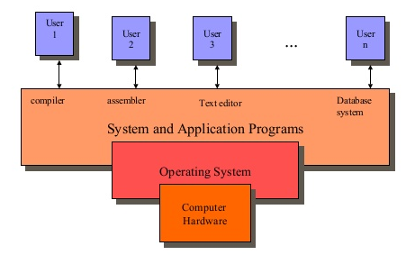
Views
The operating system can be viewed as system perspective and user perspective.
End user, application programmer, and operating system programmer use different aspects of a computer.
The end user employs the application programs
The application programmer uses the system program/software to produce application program and
The operating system programmer uses the hardware to implement system software
Figure Abstract View of OS

Slide 3
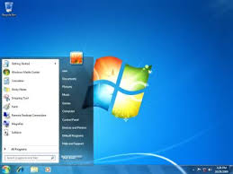
User View
In user view users simply uses the services provided by OS, hence it called as “top-down approach”
User gets virtual machine to use, and it provided by OS itself.
This approach hides the low-level hardware mechanism.
User need not to bother about how these activities were provide by the Operating System
(i.e. need not to worry about background activity of OS).
Simply user would be very happy to see "Look at Feel" i.e. what we see?
Working:-
The implementation starts with the system call handler and checks what mechanism and data structure are needed to support them, these procedures are written until the hardware is reached.
Drawback:-
The problem with this approach is that it is hard to test everything with only the top-down procedure available.
For this reason many developers find it more practical to build system bottom up.
Examples:-
PC/Workstation—single user---Convenience---Interface
Mainframe Computer (multi user) – Utilization of resources H/W—network for sharing information
Handheld Computer---Convenience and Utilization (Battery life)

Slide 4

System View
A system view, where OS acts as
"Resource Allocator", and
“Program Controller” / Execution of program
Consider the situation in multi processing environment the OS: assign the resource to each process
Effectively and
Faire
OS is responsible to carry out all internal activities without knowing to the user.
This approach is also called as "bottom-up approach".

Slide 5
Thank You
We will meet Soon!!!!!!!!!!

